Slide 1

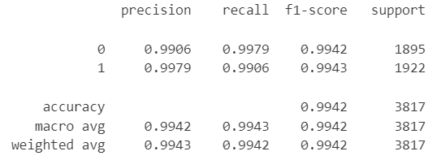
Claims classification project. Alternative algorythms
Executive summary report
TikTok is working on the development of a predictive model that can determine whether a video contains a claim or offers an opinion. With a successful prediction model, TikTok can reduce the backlog of user reports and prioritize them more.
At this stage of the project TikTok data Team try alternative approach and try to build model based on alternative algorithms.
Random Forest and XGBoost models were chosen for this activity with approach to chose model with the highest Recall score performance
Both models showed great performance with XGBoos slightly better score on the train data.
Both models prevailed Logistic regression performance
Recall score for XGBoost is 99.06% on the test data in comparioson 86% with Logistic regression
XGBoost model was chosen as a final model. Before deploying the model, the data team recommends further evaluation using additional subsets of user data. It is recommended monitoring the distributions of video engagement levels to ensure that the model remains robust to fluctuations in its most predictive features.

